Slide 1
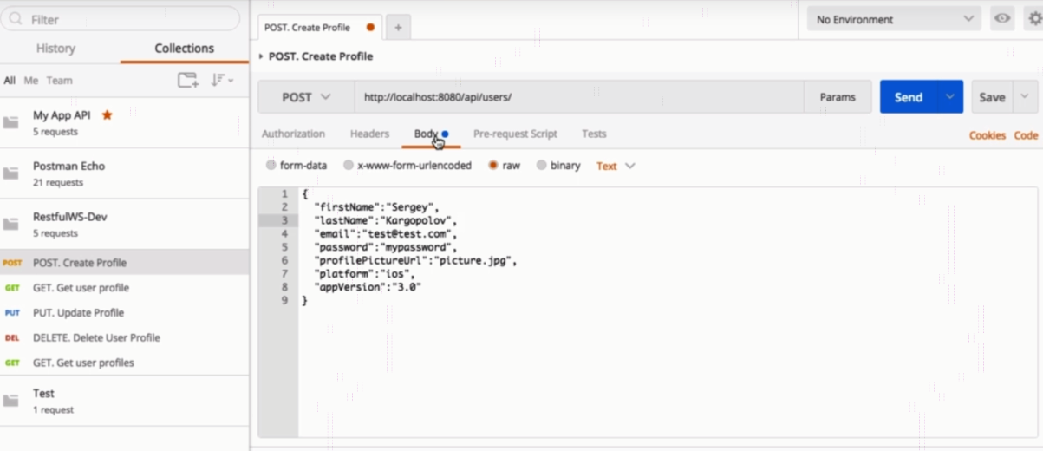
HTTP Headers: Accept and Content Type

Slide 2
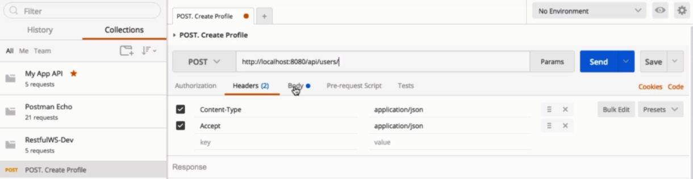
HTTP Headers: Accept and Content Type

Slide 3
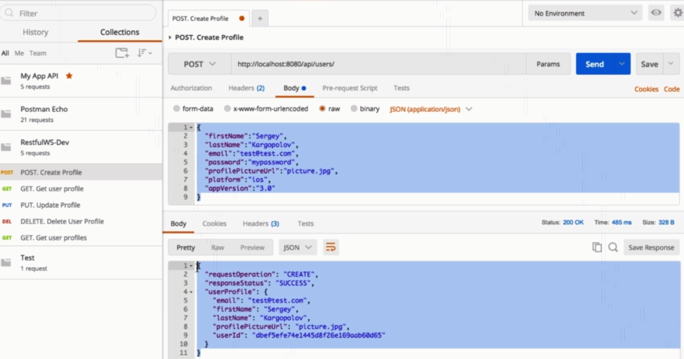
HTTP Headers: Accept and Content Type

Slide 4
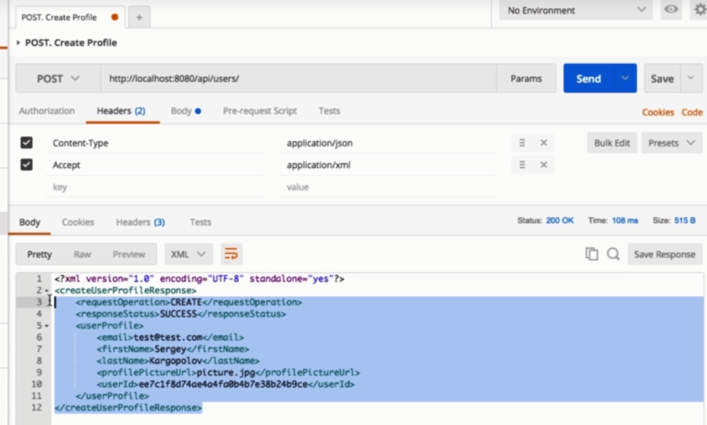
HTTP Headers: Accept and Content Type

